Slide 1


Maryam Ibrahim
10.12.2024

Slide 2

Outline
Executive Summary
Introduction
Methodology
Results
Conclusion
Appendix

Slide 3
Executive Summary
Summary of methodologies
Data Collection through API
Data Collection with Web Scraping
Data Wrangling
Exploratory Data Analysis with SQL
Exploratory Data Analysis with Data Visualization
Interactive Visual Analytics with Folium
Machine Learning Prediction
Summary of all results
Exploratory Data Analysis result
Interactive analytics in screenshots
Predictive Analytics result

Slide 4
Introduction
Project Background and Context:
SpaceX offers Falcon 9 rocket launches at a cost of $62 million, significantly lower than competitors who charge upwards of $165 million per launch. This cost savings is largely due to SpaceX's ability to reuse the first stage of the rocket, which lands back on Earth after launch. The success of this landing is crucial for the cost-effectiveness of the launch, as the first stage is reused for future missions. Predicting whether the first stage will land successfully could be a game-changer, not only for SpaceX but also for any competing companies looking to bid against SpaceX for rocket launches. By creating a machine learning pipeline to predict landing success, this project aims to optimize launch operations, reduce costs, and provide valuable insights for future missions.
Problems You Want to Find Answers:
Questions include: What operational conditions, such as altitude, velocity, and weather, influence landing success? How do these factors interact with one another to affect the likelihood of a successful landing? Additionally, the project will explore the optimal operating conditions necessary to ensure a successful landing program, which could include specific weather patterns, rocket settings, and timing during flight. By answering these questions, the project aims to provide actionable insights to improve the success rate of rocket landings and help companies better plan for future space launches.

Slide 5

Section 1

Slide 6
Methodology
Executive Summary
Data collection methodology:
Data was collected through the SpaceX API and web scraping from Wikipedia.
Perform data wrangling
The data was prepared for analysis and modeling by filtering, handling missing values, and applying one-hot encoding.
Perform exploratory data analysis (EDA) using visualization and SQL
Perform interactive visual analytics using Folium and Plotly Dash
Perform predictive analysis using classification models
How to build, tune, evaluate classification models

Slide 7
Data Collection
Identify Data Sources
SpaceX API, Wikipedia
Data Request
API request for Falcon 9 launch data
Custom functions for payload mass, velocity, altitude, weather
Data Parsing and Conversion
Decode with .json()
Convert to dataframe using .json_normalize()
Data Organization
Store data in a dictionary
Convert dictionary to dataframe
Data Filtering
Filter for Falcon 9 launches
Handling Missing Values
Impute missing payload mass with mean
Data Export
Export cleaned data to CSV

Slide 8

Data Collection – SpaceX API
I used a GET request to the SpaceX API to collect data, then cleaned and performed basic data wrangling and formatting on the requested data.
https://github.com/m4ryan/Capstone-Project/blob/main/SpaceX_Data_Collection_API.ipynb

Slide 9
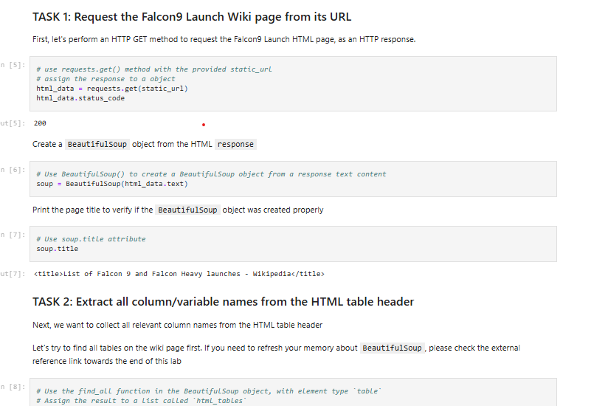
Data Collection - Scraping
I used web scraping with BeautifulSoup to extract Falcon 9 launch records, parsed the table, and converted it into a pandas dataframe.
https://github.com/m4ryan/Capstone-Project/blob/main/SpaceX_Web_Scraping.ipynb

Slide 10
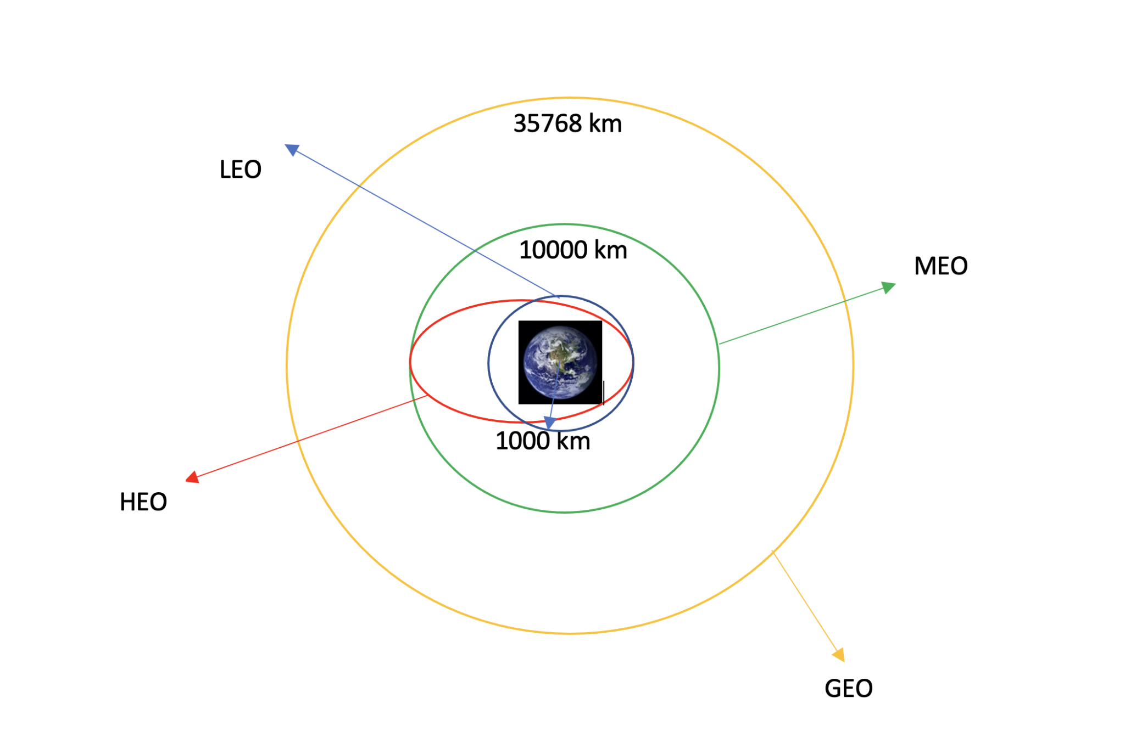
Data Wrangling
I conducted exploratory data analysis to determine the training labels. I calculated the number of launches at each site and analyzed the frequency of each orbit type. I created a landing outcome label from the outcome column and exported the results to a CSV file.
https://github.com/m4ryan/Capstone-Project/blob/main/SpaceX_Data_Wrangling.ipynb

Slide 11


EDA with Data Visualization
I analyzed the data by visualizing the connections between flight number and launch site, payload and launch site, success rate across different orbit types, flight number and orbit type, and the annual trend of launch success.
https://github.com/m4ryan/Capstone-Project/blob/main/SpaceX_EDA_Data_Visualization.ipynb

Slide 12
EDA with SQL
I loaded the SpaceX dataset into a PostgreSQL database directly from the Jupyter notebook. Using SQL, I performed exploratory data analysis to gain insights from the data. I wrote queries to retrieve information such as:
The names of unique launch sites in the space mission.
The total payload mass carried by boosters launched by NASA (CRS).
The average payload mass carried by booster version F9 v1.1.
The total number of successful and failed mission outcomes.
The failed landing outcomes on the drone ship, along with their booster version and launch site names.
https://github.com/m4ryan/Capstone-Project/blob/main/SpaceX_EDA_SQL.ipynb

Slide 13
Build an Interactive Map with Folium
I marked all launch sites on a Folium map and added map objects such as markers, circles, and lines to indicate the success or failure of launches for each site. I assigned the launch outcomes (failure or success) to classes 0 and 1, with 0 representing failure and 1 representing success. Using color-labeled marker clusters, I identified which launch sites had relatively high success rates. I also calculated the distances between launch sites and their proximities, answering questions like:
Are launch sites located near railways, highways, and coastlines?
Do launch sites maintain a certain distance from cities?

Slide 14
Build a Dashboard with Plotly Dash
I built an interactive dashboard using Plotly Dash. I plotted pie charts to show the total number of launches at each site and created scatter graphs to visualize the relationship between launch outcomes and payload mass (kg) for different booster versions.
https://github.com/m4ryan/Capstone-Project/blob/main/SpaceX_Interactive_Visual_Analytics_Plotly.py

Slide 15
Predictive Analysis (Classification)
I loaded the data using NumPy and pandas, transformed it, and split it into training and testing sets. I built different machine learning models and tuned various hyperparameters using GridSearchCV. Accuracy was used as the metric to evaluate the models, and I improved performance through feature engineering and algorithm tuning. Ultimately, I identified the best-performing classification model.
https://github.com/m4ryan/Capstone-Project/blob/main/SpaceX_Predictive_Analytics.ipynb

Slide 16
Results
Exploratory data analysis results
Interactive analytics demo in screenshots
Predictive analysis results

Slide 17

Section 2

Slide 18
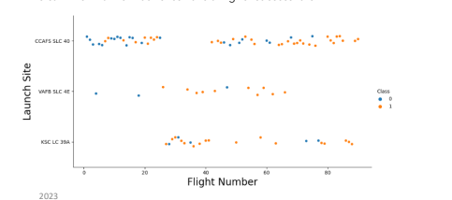
Flight Number vs. Launch Site
Exploratory Data Analysis
Earlier flights had a lower success rate, with failures marked in blue.
Later flights showed a higher success rate, with successes marked in orange.
About half of the launches occurred at the CCAFS SLC 40 launch site.
VAFB SLC 4E and KSC LC 39A exhibited higher success rates.
From these observations, we can infer that newer launches generally have a higher success rate.

Slide 19
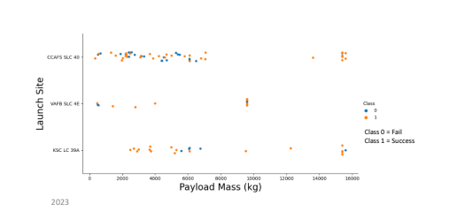
Payload vs. Launch Site
Exploratory Data Analysis
Generally, higher payload mass (kg) correlates with a higher success rate.
Most launches with a payload greater than 7,000 kg were successful.
KSC LC 39A has a 100% success rate for launches with payloads under 5,500 kg.
VAFB SLC 4E has not launched any payloads greater than approximately 10,000 kg.

Slide 20
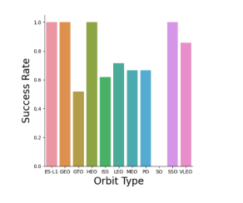
Success Rate vs. Orbit Type

Slide 21

Flight Number vs. Orbit Type

Slide 22

Payload vs. Orbit Type

Slide 23
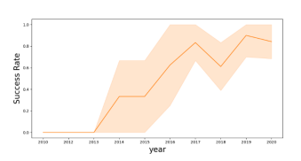
Launch Success Yearly Trend

Slide 24

All Launch Site Names
Launch Site Names
• CCAFS LC-40
• CCAFS SLC-40
• KSC LC-39A
• VAFB SLC-4

Slide 25

Launch Site Names Begin with 'CCA'
I used the query above to display 5 records where launch sites begin with `CCA`

Slide 26

Total Payload Mass
I calculated the total payload carried by boosters from NASA, which amounted to 45,596 kg, using the following query

Slide 27

Average Payload Mass by F9 v1.1
I calculated the average payload mass carried by booster version F9 v1.1, which was 2,928.4 kg.

Slide 28

First Successful Ground Landing Date
I observed that the date of the first successful landing outcome on the ground pad was December 22, 2015.

Slide 29

Successful Drone Ship Landing with Payload between 4000 and 6000
I used the WHERE clause to filter for boosters that successfully landed on the drone ship and applied the AND condition to identify successful landings with a payload mass greater than 4000 but less than 6000.

Slide 30

Total Number of Successful and Failure Mission Outcomes
I used the wildcard '%' to filter for rows where the MissionOutcome was either a success or a failure in the WHERE clause.

Slide 31

Boosters Carried Maximum Payload
I determined the booster that carried the maximum payload by using a subquery in the WHERE clause along with the MAX() function.

Slide 32

2015 Launch Records
I used a combination of the WHERE clause, LIKE, AND, and BETWEEN conditions to filter for failed landing outcomes on the drone ship, along with their booster versions and launch site names for the year 2015.

Slide 33

Rank Landing Outcomes Between 2010-06-04 and 2017-03-20
I selected landing outcomes and the COUNT of landing outcomes from the data, using the WHERE clause to filter for landing outcomes between 2010-06-04 and 2010-03-20. I applied the GROUP BY clause to group the landing outcomes and the ORDER BY clause to arrange the grouped landing outcomes in descending order.

Slide 34

Section 3

Slide 35
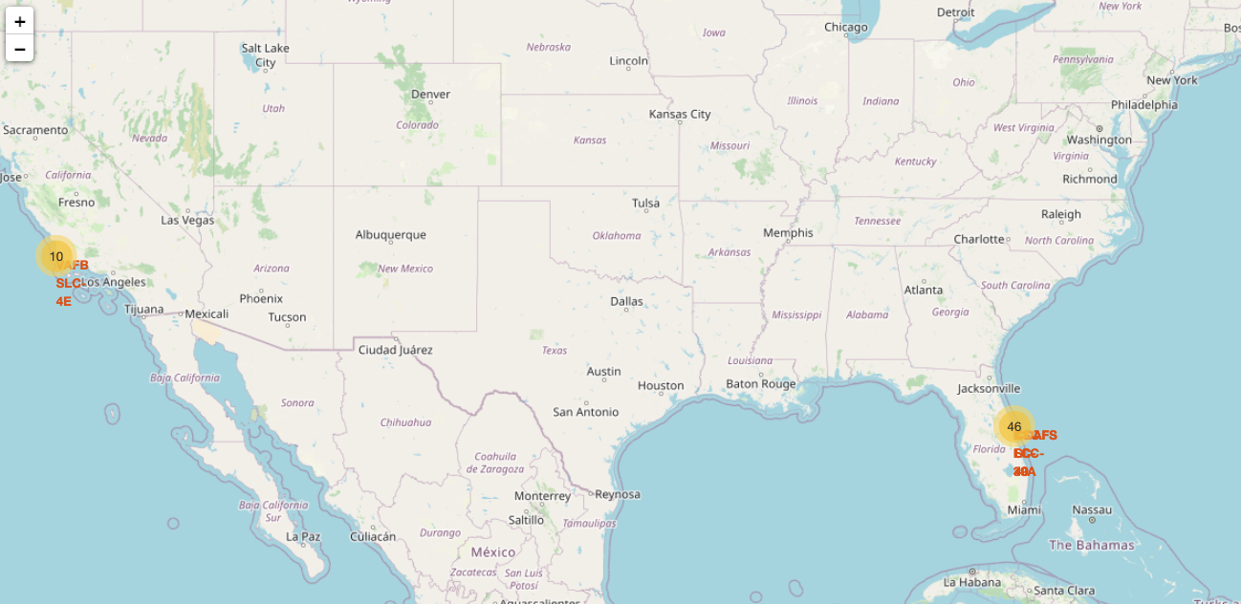
<Folium Map Screenshot 1>

Slide 36

<Folium Map Screenshot 2>

Slide 37

<Folium Map Screenshot 3>

Slide 38

Section 4

Slide 39
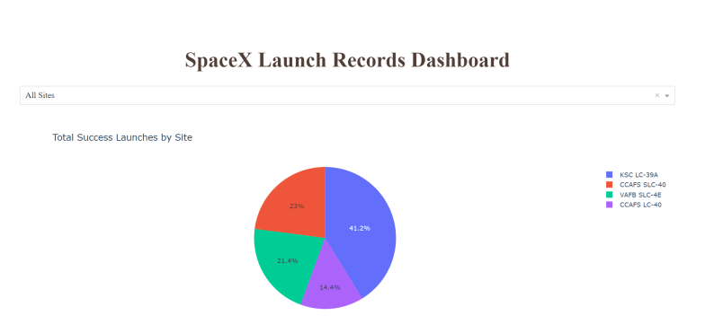
<Dashboard Screenshot 1>

Slide 40
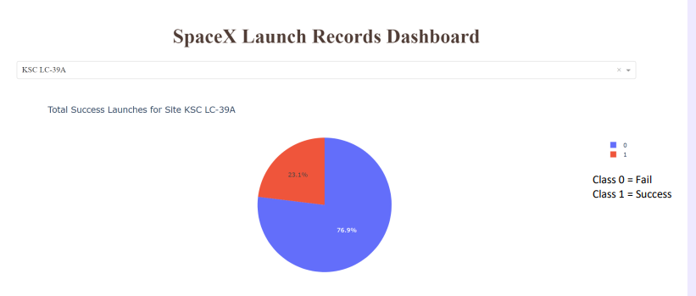
<Dashboard Screenshot 2>

Slide 41
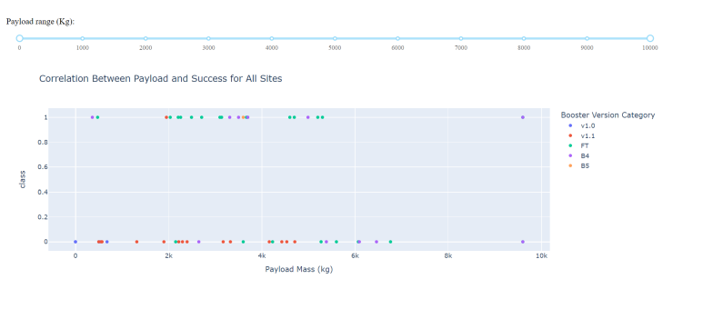
<Dashboard Screenshot 3>

Slide 42

Section 5

Slide 43

Classification Accuracy
The decision tree classifier is the model that achieved the highest classification accuracy.

Slide 44

Confusion Matrix
The confusion matrix for the decision tree classifier indicates that the model is able to differentiate between the various classes. However, a significant issue is the presence of false positives, where unsuccessful landings are incorrectly classified as successful landings.

Slide 45
Conclusions
I can conclude that:
The more flights a launch site has, the higher the success rate at that site.
The launch success rate began to increase from 2013 and continued to improve until 2020.
Orbits such as ES-L1, GEO, HEO, SSO, and VLEO had the highest success rates.
KSC LC-39A recorded the most successful launches among all sites.
The decision tree classifier is the best machine learning algorithm for this task.

Slide 46
Appendix
Include any relevant assets like Python code snippets, SQL queries, charts, Notebook outputs, or data sets that you may have created during this project

Slide 47


